Slide 1
Word2Vec Neural Network
Jay Uppuluri – Saama 2018

Slide 2
Function
Word2Vec is a two-layer neural network used for processing text

Slide 3
Word2Vec Techniques
Continuous Bag-Of-Words (CBOW): Use context words to predict target center word
Skip-Gram: Use center word to predict target context. Output vector is a probability distribution

Slide 4
Word Embedding
Fixed Embedding
Fixed encodings are created for words in a fixed vocabulary (useful for drug/disease entities)
Variable Embedding
Neural network learns representations for recurring words/phrases

Slide 5
Using word2vec in ADE
Input: Sentence
Hidden Activity: Probability distribution generated for associated words (eg. Adverse Event)
Output: Word Vectors

Slide 6
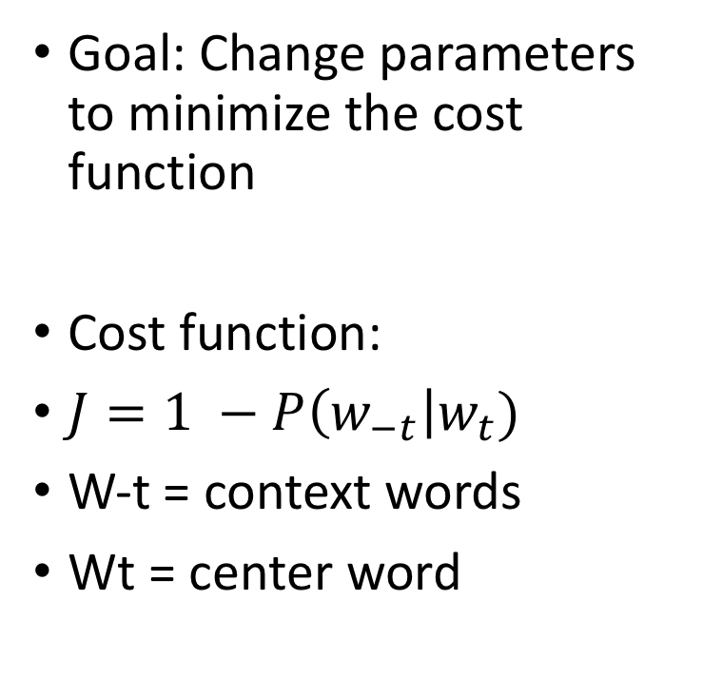
Gradient Descent
Goal: Change parameters to minimize the cost function
Cost function:
$J=1 −P\left(w_{−t}\right|w_{t})$
W-t = context words
Wt = center word

Slide 7
Example with AE-Pos Sentence
Sentence
first report possible association acute cardiovascular event venlafaxine.
ACUTE: (acute, cardiovascular) (acute, event) (acute, venlafaxine)
CARDIOVASCULAR: (cardiovascular, acute) … (cardiovascular, venlafaxine)
EVENT: (event, acute) … (event, venlafaxine)
VENLAFAXINE: (venlafaxine, acute) (venlafaxine, cardiovascular)…

Slide 8
Sources
https://groups.google.com/d/msg/gensim/EwK-6JgkWVI/_coANN5pBwAJ
https://stats.stackexchange.com/questions/280222/why-the-skip-gram-model-is-called-as-predicting-source-context-words-from-the-ta
https://medium.com/data-science-group-iitr/loss-functions-and-optimization-algorithms-demystified-bb92daff331c
https://medium.com/deeper-learning/glossary-of-deep-learning-word-embedding-f90c3cec34ca

